Slide 1
Substitution-based White-box oriented block cipher with Affine Networks
Zheng Gong, Weijie Li, Guohong Liao, Guojun Tang, Zhaoji Xu
School of Computer Science, SCNU
Bing Sun
School of Math, NDTU
Siwei Sun, Yingjie Zhang
CAS, IIE
Last updated: 13 April, 2019

Slide 2
Foreword
We hope SWAN is elegant in both of the black-box and white-box models.
The final goal of SWAN is not only for the contest, but also it is dedicated to explore “white-box friendly” block ciphers for practice.
Possibilities
Concrete security analysis
Many valuable discussions and comments that received from our early talks
SJTU: Lai xuejia
CAS: Wu wenling, Zhang lei
Westone: Zhang liting, Pan wenlun
NTU: Wu hongjun, Guo jian, Song ling, Zhang wenying, Bao zhenzhen, Liu guozhen
Bauhaus-Universität Weimar: Eik List
HYNU: Li lang
...

Slide 3

Outlines
Design background
Research background
Related work
Our proposal: SWAN
Conclusion

Slide 4
Outlines
Design background
Research background
Related work
Our proposal: SWAN
Conclusion

Slide 5
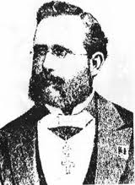
The Kerckhoffs's principle
A cryptographic system should be secure even if everything about the system, except the key, is public knowledge.
How to keep the key be private?
Auguste Kerckhoffs

Slide 6
Key protections for different purposes
To my opinion, there are three types of key protections
Key binding: attackers can not modify/remove the key from implementations.
e.g., IMEI/IMSI in mobile phones.
Key confidentiality: attackers can not extract the key from implementations.
e.g., PUFs, signatures, MACs.
Key asymmetry: Given an encryption/decryption implementation, attackers can not reduce to its decryption/encryption equivalence.
e.g., block ciphers.

Slide 7
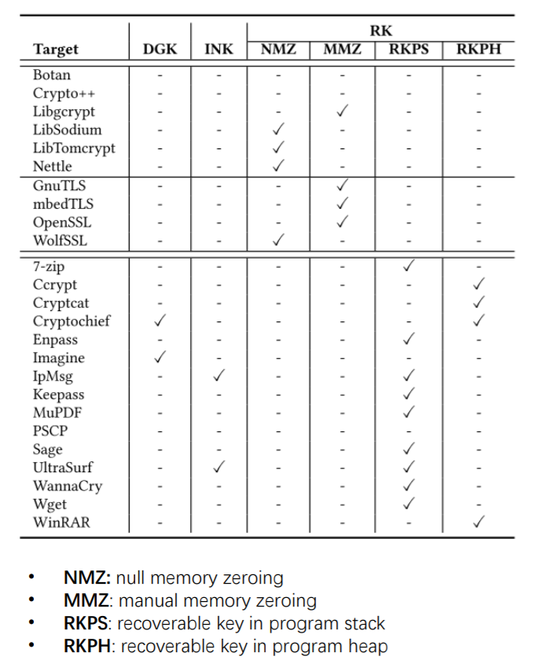
K-Hunt key recovery tools
Recently published by sjtu Li et al. @ccs 2018
Finding insecure key from cryptographic libraries
open-source: openssl, mbedtls
commercial: 7zip
Results are negative

Slide 8
The practical issues of key protection
Who pay more attentions to key protection?
Hardware manufacturers
Operating systems
Software developers
Rely on the Kerckhoffs's principle
Algorithm designers
End users
For massive-user applications, it is an issue
Costs
Interoperability
Device compatibility

Slide 9
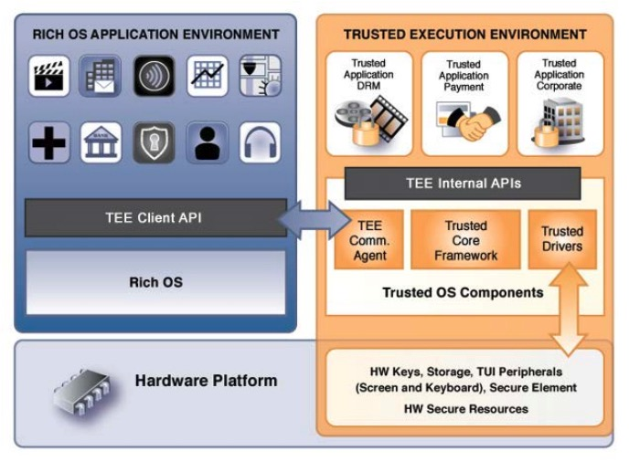
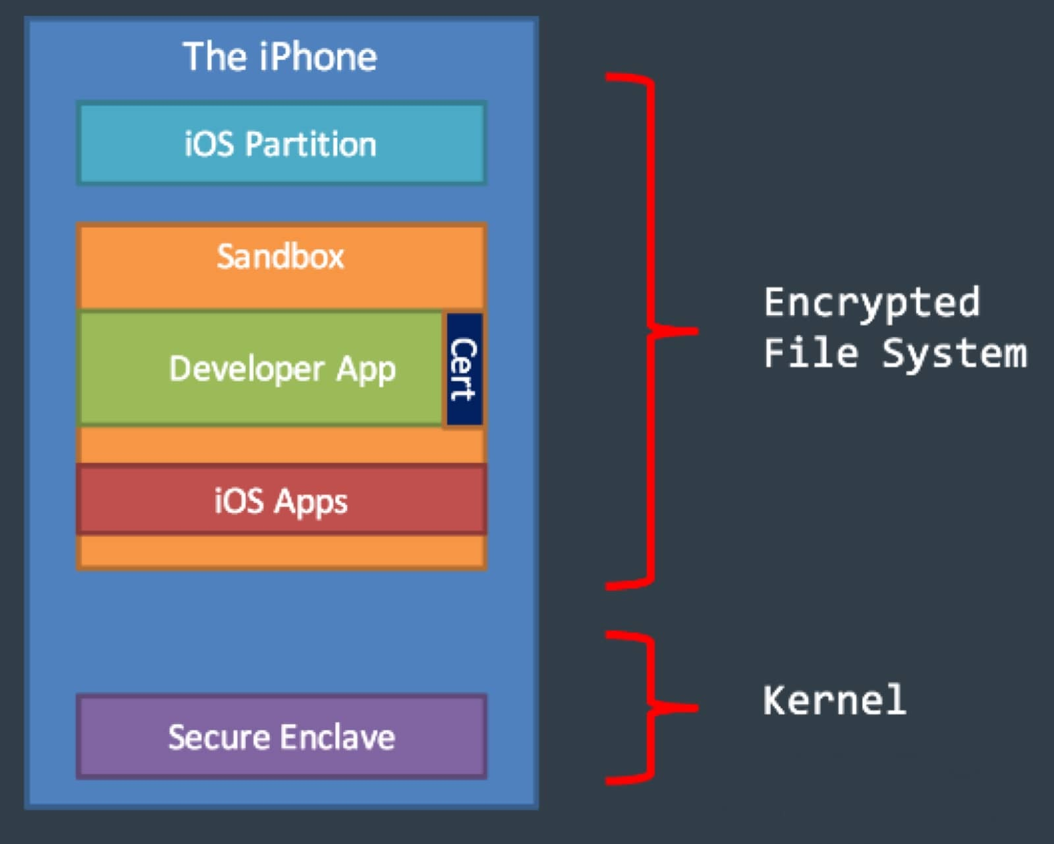
Techniques for mobile applications: TEE/SE
TEE is a hardware-supported trusted computing basis
Standardized by Globleplatform
Supported by ARM, Intel, MTK, HUAWEI, STM, etc.
SE (Secure Enclave) is a crypto engine chip for securely execute the cryptographic algorithms
Supported by Apple and Samsung

Slide 10
Practical issues of hardware solutions
TEE/SE still need trusting bases on root keys
many attacks were proposed on extracting root keys
Hardware becomes a black-box solution
hard to support various of cryptosystems
Price
Especially hinder the IoT applications

Slide 11

The adversary model of binay codes
Algorithm
Obfuscation
Reverse Engineering
Debug
Programming
Code
Compiling
Binary
Executing
Trusted environment
Neutral environment
Hostile environment
In software implementations, algorithm is the last defense!

Slide 12
What is “white-box”?
From software engineering:
wiki^{[1]}: A white box (or glass box, clear box, or open box) is a subsystem whose internals can be viewed but usually not altered.
White-box crypto
which refers to the protection of cryptographic secrets, when running environments are under the fully control of adversary
[1]https://en.wikipedia.org/wiki/White_box_(software_engineering)

Slide 13
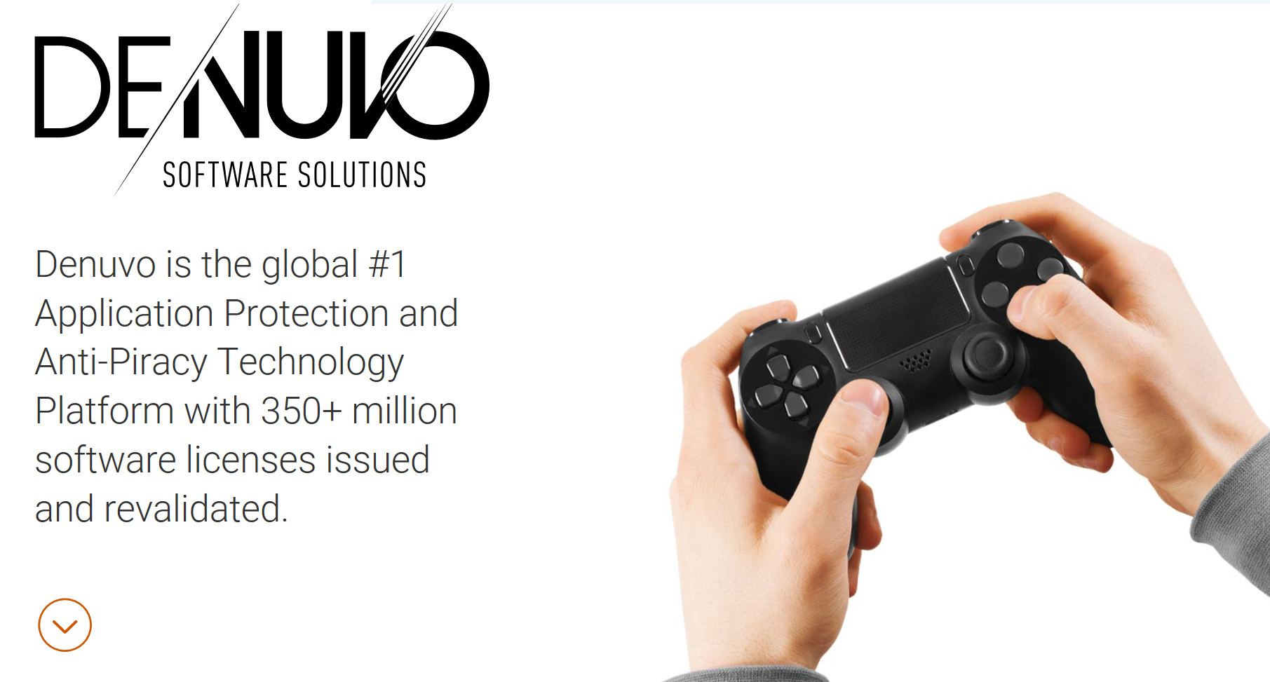
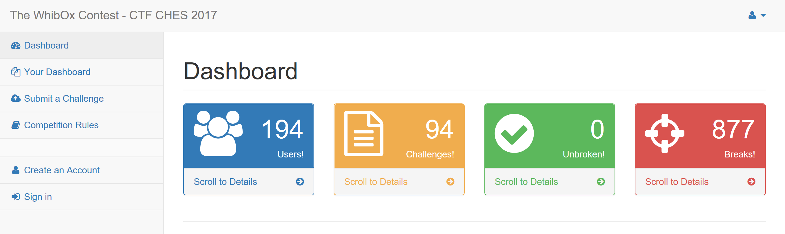

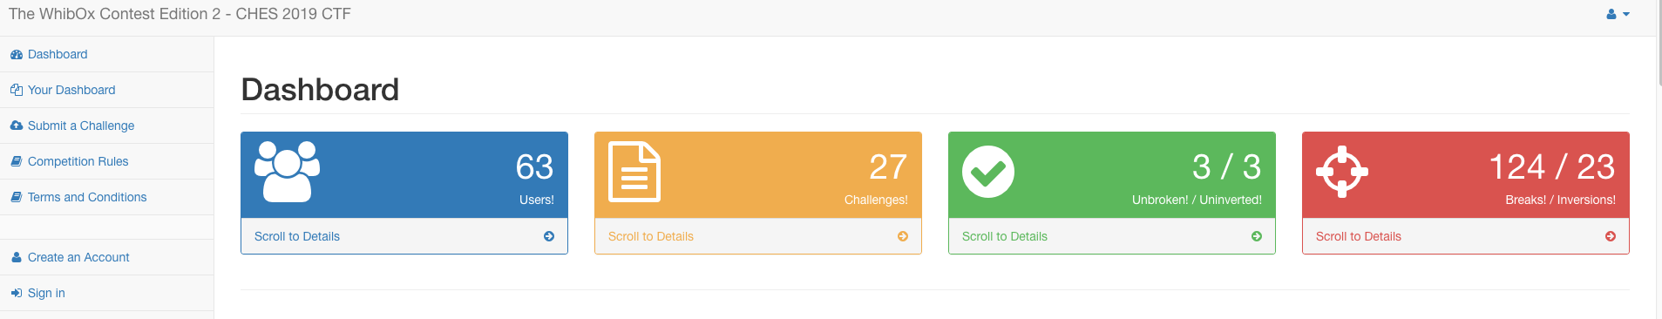

Industrial and academic cases of WBC
WBC used in STEAM
WB-AES Contest on CHES'17
WB-AES CTF on CHES'19
*100MB source code limitation！

Slide 14
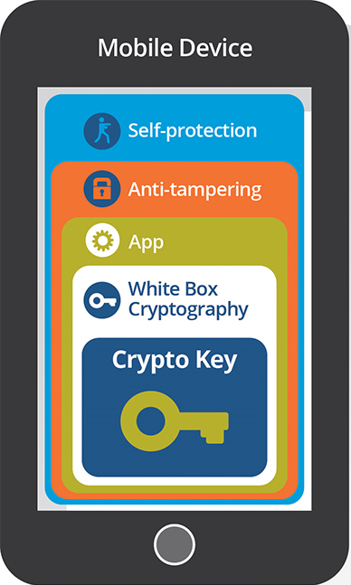

Typical Mobile Applications with WBC
0. Algorithm Designing
1. Authentication
2. Binding info
3. Whitening key(s)
(Fully?) Trusted Server
WBC Compiler
Necessary
Optional

Slide 15
Outlines
Design background
Research background
Related work
Our proposal: SWAN
Conclusion

Slide 16
The proposed definitions of white-box block ciphers
(Weak) WBC (WWBC, Chow et al. 2002)
Attackers can not extract secret keys (or equivalent key) from the implementation
Cannot extract a compact description of E_{k}(.)
WWBC does not prevent the extraction/duplication/execution of WB(E_{k}(.))
Strong WBC (SWBC, Biryukov 2014)
Achieve WWBC
Given WB(E_{k}(.)), Attackers can not extract D_{k}(.)

Slide 17
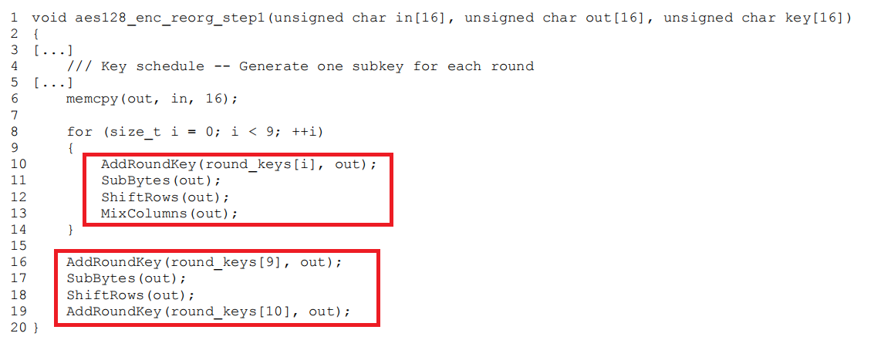
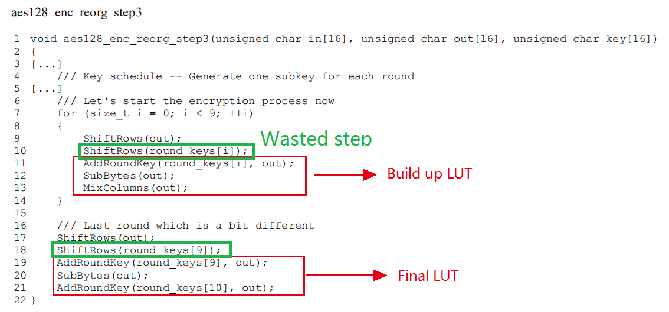
Chow et al.'s white-box AES

Slide 18
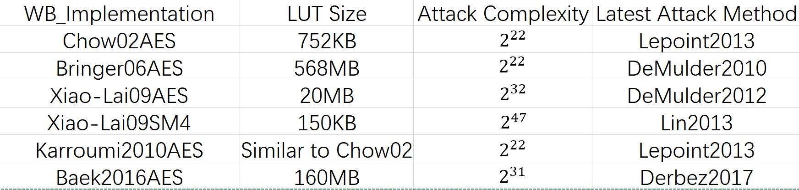
Attacks on WB-AES/SM4
Chow02AES and Xiao-Lai09SM4 are the most widely used WBC in mobile applications (at least in China).
Some commercial uses obfuscated compiler and WBC together for stronger protection.

Slide 19
Attacks on Chow et al.'s WBC: Resovling Affine Networks
LE and AE problems
Given a bijection with affine network T_{k}[x]=A*S[x+k]*B
Recover S[x+k] from T_{k}[x]
Solving algorithm
[PGC98, BCBP03, Dinur18, DFLM18]
Complexity
O(m³2^{m}) for LE
O(m³2^{2m}) for AE [BCBP03]
Improved to O(m³2^{m}) on certain cases [DFLM18] (failed on a certain case of WB-AES)[Dinur18]
For a 16-bit sbox, the upper bound solving complexity is
(2⁴)³ * (2^{2*16})=2⁴⁸

Slide 20
ASASA-like designs
SASAS construction: broken in 2001 by Biryukov et al.
ASASA constructions (Biryukov et al., 2014)
Proposed for achieving strong WBC property
Affine network and sbox must be secret
Recent proposals at ToSC'17 by Biryukov et al. to use more layers, leading to SA. . . SAS

Slide 21
Side-channel attacks on ASASA
[Bos et al. 2015] introduces differential computation analysis to mount key-recovery attack on WBC
Differential computation analysis is similar to timing/cache attack
DCA recovers the hidden sbox, while timing/cache attack recovers the key directly
[Bos et al. 2016] introduces differential fault analysis on WBC

Slide 22
New approaches of WBC
WhiteBlock from Fouque et al. (AC 2016)
“Efficient and Provable White-Box Primitives”
Hard to verify, very artifical model and construction
The SPACE block cipher
GFN structure (Bogdanov et al., CCS 2015 )
The SPNBox block cipher
SPN structure (Bogdanov et al., AC 2016)

Slide 23
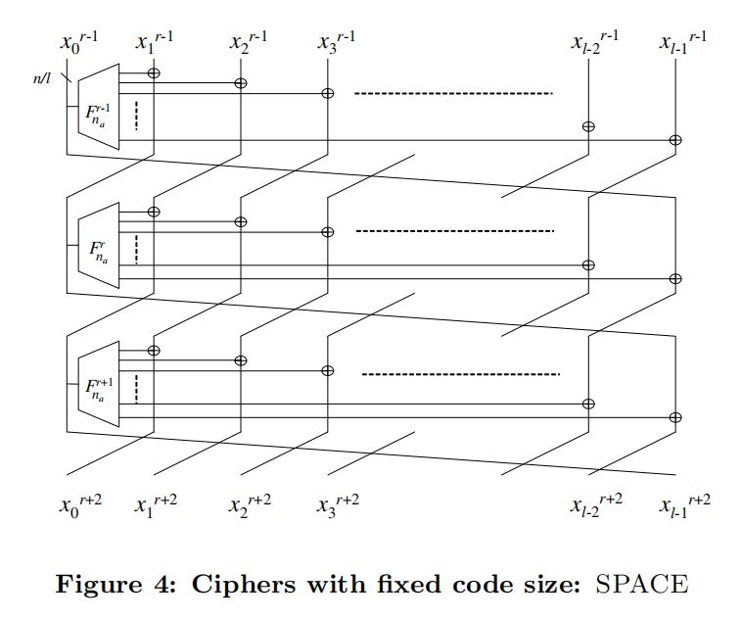
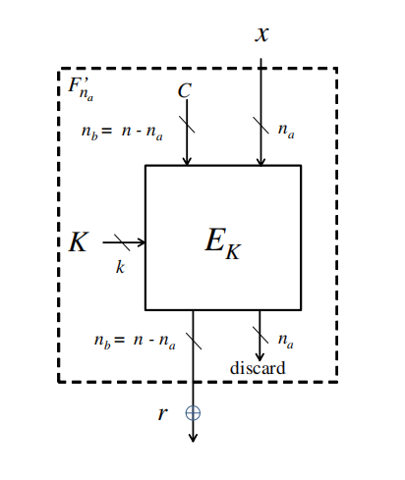
SPACE - Bogdanov et al. CCS 2015
GFN structure
Build the F function from a block cipher E with key K
F:{0,1}⁸->{0,1}¹²⁰
Problem: GFN is self-inversable without the secret key

Slide 24
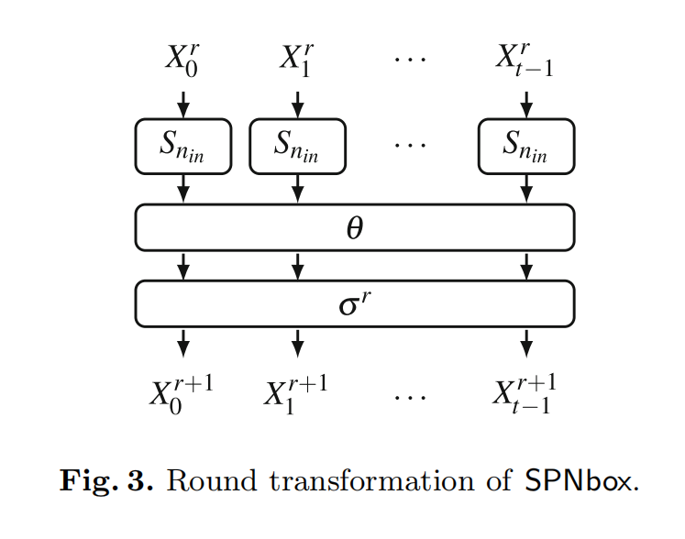
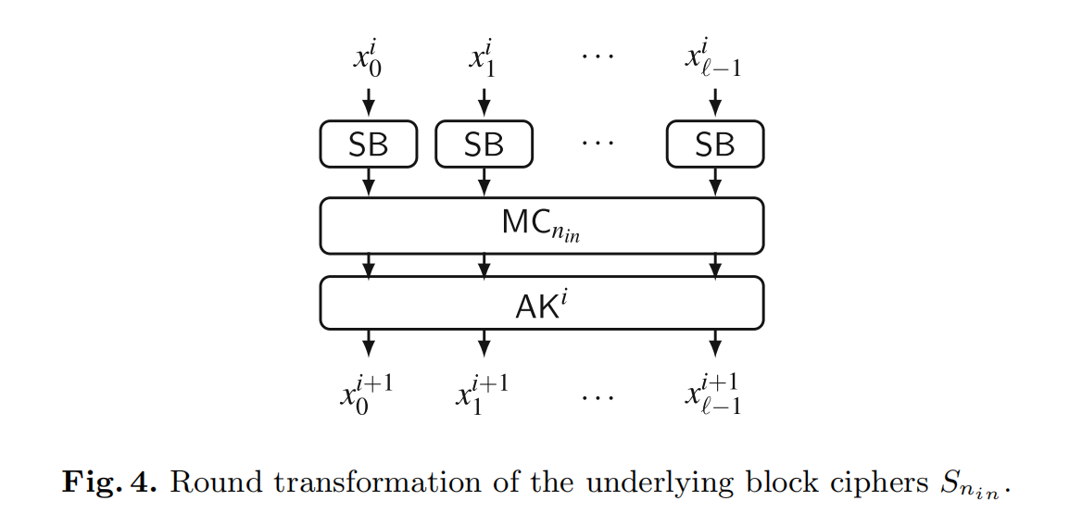
SPNBox - Bogdanov et al. AC2016
Problem 2: How to build an 8bit to 8bit
128-bit key-dependent sbox?
Problem 1: All the components are bijective on small finite fields,
thus their inverse functions are easy to compute.

Slide 25
Affine networks (ASASA) may still necessary
Consider any ideal white-box cipher in Feistel
without affine networks it is self-inversable
Consider any ideal white-box cipher in SPN
without affine networks it can find inverses of its components
Thus SPACE/SPNBox can only achieve weak WBC
Secret key cannot be recovered
But given Enc is easy to reduce Dec, and vice versa.

Slide 26
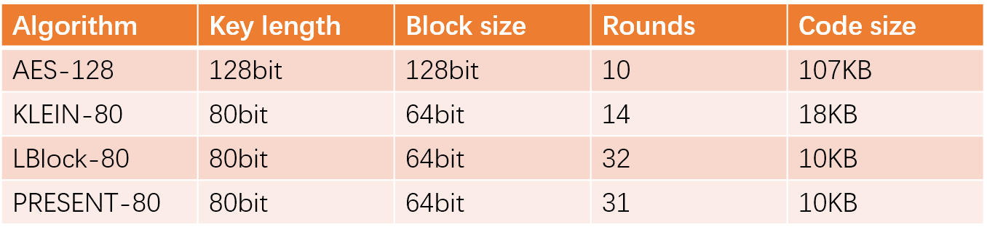
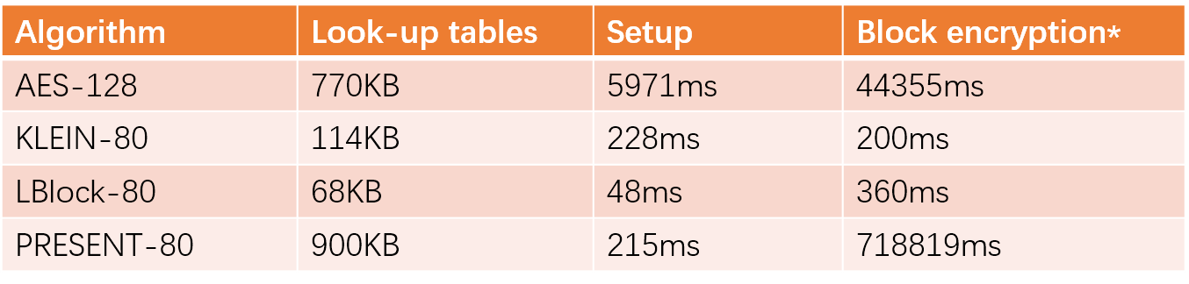
Our white-box implementations on lighweight block ciphers
*The block encryption time is calculated with 2²⁰ times encryption in total (not average).
*Published at FGCS online: https://doi.org/10.1016/j.future.2018.04.011

Slide 27
Outlines
Design background
Research background
Related work
Our proposal: SWAN
Conclusion

Slide 28
The design rationle of SWAN
Flexible for various platforms
Software/hardware efficient
8/32/64-bit CPUs
Programming-friendly components
Scalable block/key sizes
Lightweight: SWAN64-128/256
Normal: SWAN128-128/256
High security/throughput: SWAN256-256
Carefully designed for white-box implmentation
Affine-network-friendly structure
SWAN Repository:https://github.com/GongZheng/SWAN.git

Slide 29
The SWAN round function
>>> cyclic right shift
subkey
d=3/7/15bytes
ShiftLanes
Bitslicing sboxes
SwitchLanes

Slide 30
The function
 | SWAN64 | SWAN128 | SWAN256
a | 1 | 1 | 1
b | 2 | 3 | 9
c | 7 | 13 | 19
Block width | 8 | 16 | 32
Exhaustive search the combination with good diffusion property
co-prime with each other
Each combinations are co-prime to the block widths of SWAN64/128/256*
SWAN64 is a special case

Slide 31
The function of SWAN64

Slide 32
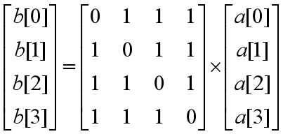
The function
It is an Almost MDS matrix
Lightweight in hardware and software
Friendly for white-box implementation

Slide 33
The SWAN sbox
x | 0 | 1 | 2 | 3 | 4 | 5 | 6 | 7 | 8 | 9 | A | B | C | D | E | F
S[x] | 1 | 2 | C | 5 | 7 | 8 | A | F | 4 | D | B | E | 9 | 6 | 0 | 3
We choose the optimal secure 4-bit sbox
Cryptographic property
MDP: 2⁻²
MLP: 2⁻²
Threshold implementation friendly
(2,2)-step shares

Slide 34
The SWAN sbox
Simple bitslicing
fast β-Function implementation
Opitmal security
MDP/MLP
Threshold Implemenation [2]
No fixed-points
avoid invariant subspace
SBox classification | Block cipher | MinWeight
223 | Noekeon Luffa v1 Piccolo | 214
266 | PRESENT Serpent 2/6 SWAN | 339
296 | Serpent 1 | 407
297 | Serpent 0
[2] B. Bilgin et al. Threshold Implementations of All 3 × 3 and 4 × 4 S-Boxes. CHES 2012, Springer LNCS 7428, pp. 76-91, 2012.

Slide 35
SWAN function
Input: 4-tuple array a = a[0]a[1]a[2]a[3]
Output: 4-tuple array b = b[0]b[1]b[2]b[4]
8/16/32 bits for SWAN64/128/256
β-Function is the same for different block/key lengths
b[0] = ~(a[0] ^ a[1] ^ a[3] ^ (a[2] & a[3]));
t[0] = (a[0] & a[2] & a[3]); t[1] = (a[0] & a[1] & a[3]); t[2] = (a[1] & a[2] & a[3]);
b[1] = a[0] | (a[0] & a[1]) | a[2] | (a[0] & a[3]) | (a[1] & a[3]) |t[1]| (a[2] | a[3]) | t[0] | t[2];
b[2] = a[1] | a[2] | (a[0] & a[2]) | a[3] |t[1] |t[2];
b[3] = a[1] | (a[0] & a[1]) | (a[0] & a[2]) | (a[0] & a[3]) | (a[2] & a[3]) | t[0];

Slide 36
The active sboxes comparison amongst bit-slicing ciphers
 | PRESENT | Rectangle | SWAN64
4-bit Sboxes per round | 16 | 16 | 16
Minimum propagations active sboxes | 10 / 5 rounds | 7 / 5 rounds | 14 / 4 rounds

Slide 37
The active sboxes of SWAN differential analysis
Differential analysis based on MILP and gurobi
Differential analysis active S-box lower bound | SWAN64 |  | SWAN128 |  | SWAN256
 | K128 | K256 | K128 | K256 | K256
2-round active S-box | 5 | 5 | 5 | 5 | 5
3-round active S-box | 9 | 9 | 11 | 11 | 11
4-round active S-box | 14 | 14 | >14 | >14 | >14
Full-round active S-box lower bound | >112 | >224 | >176 | >231 | >231
Full round estimation | >2⁻²²⁴ | >2⁻⁴⁴⁸ | >2⁻³⁵² | >2⁻⁴⁶² | >2⁻⁴⁶²

Slide 38
The active sboxes of SWAN differential analysis
Linear analysis based on MILP and gurobi
Linear analysis active S-box lower bound | SWAN64 |  | SWAN128 |  | SWAN256
 | K128 | K256 | K128 | K256 | K256
2-round active S-box | 5 | 5 | 5 | 5 | 5
3-round active S-box | 8 | 8 | 8 | 8 | 8
Full-round active S-box lower bound | >85 | >168 | >128 | >168 | >168
Full round estimation | >2⁻¹⁷⁰ | >2⁻³³⁶ | >2⁻²⁵⁶ | >2⁻³³⁶ | >2⁻³³⁶

Slide 39
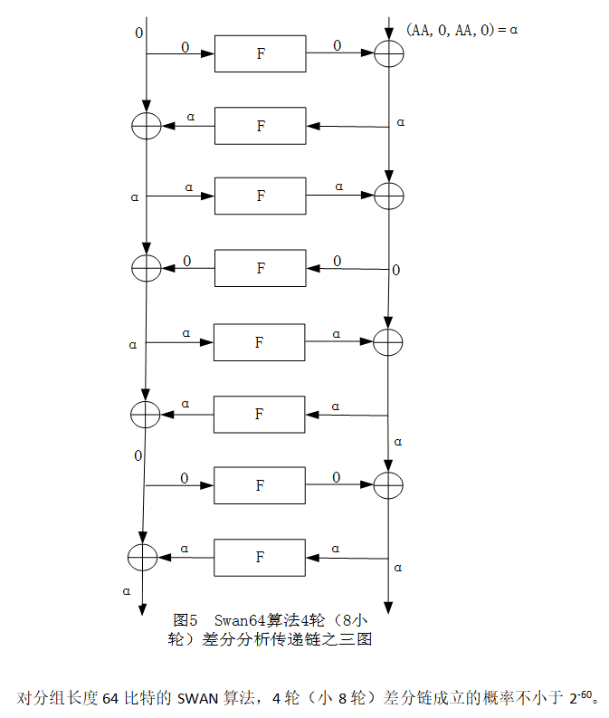
The differential of SWAN64 (3rd-party)
张道法，姚富，史晓明，刘仁章，潘文伦. SWAN算法（减轮）的分析

Slide 40
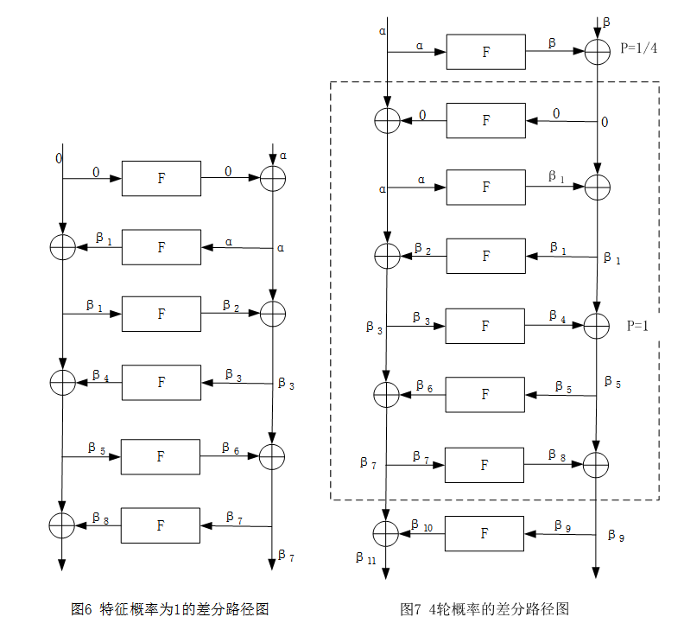
The differential of SWAN256 (3rd-party)
张道法，姚富，史晓明，刘仁章，潘文伦. SWAN算法（减轮）的分析

Slide 41
The value
 | SWAN64 | SWAN128 | SWAN256
 | 0x9e3779b9 | 0x9e3779b97f4a7c15 | 0x9e3779b97f4a7c15f39cc0605cedc834
In the black-box model,
For key-related cryptanalysis in the i-th round,
Attacker faces modular addition differential problem.

Slide 42
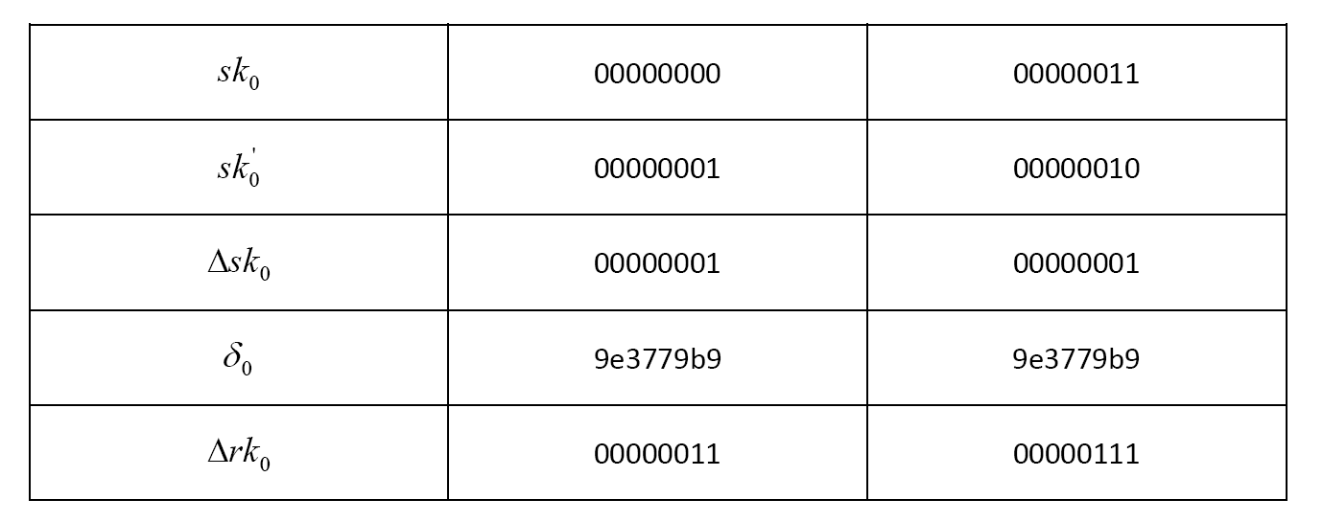
The affect of on related-key attacks

Slide 43
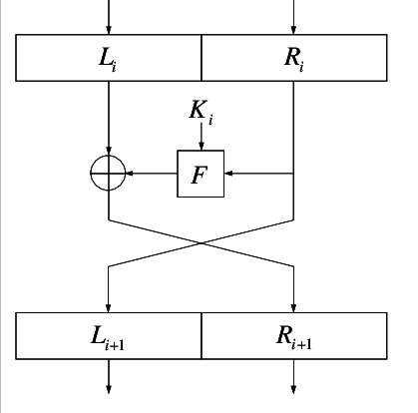
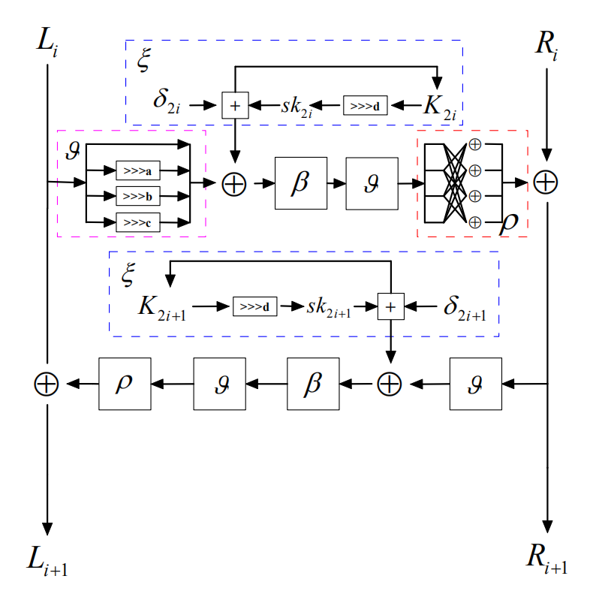
Why two-round Feistel?
Encryption = Decryption
Encryption != Decryption in WBC

Slide 44
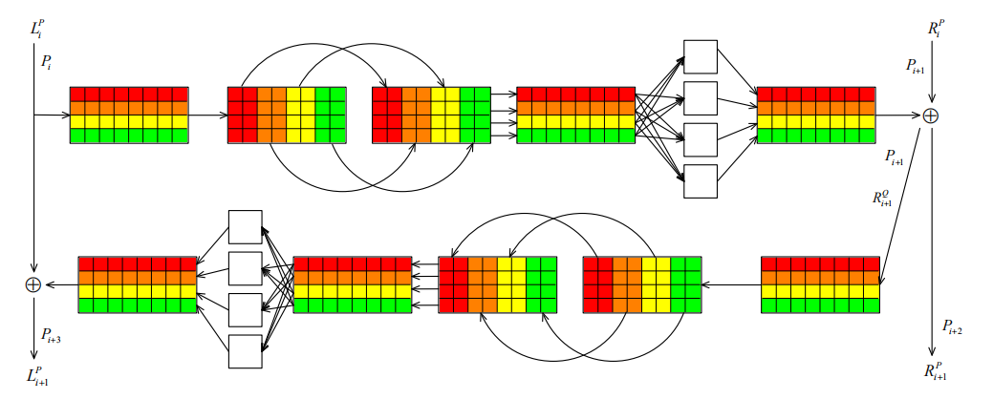
White-box mode of SWAN
Support different combinations
Type I: L->ASA->R
Type II: L->ASAASA->L
Type III, Type IV, ...

Slide 45
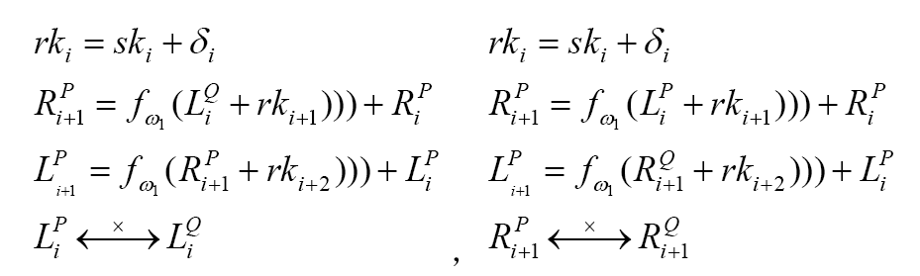
White-box secuirty analysis (1)
The white-box security of SWAN can be reduced to the affine random vectors.
f(x) = ax + b
thanks to Pan et al.'s paper
The strong white-box security is derived from

Slide 46
White-box secuirty analysis (2)
 | WBSWAN64 | WBSWAN128 | WBSWAN256
White-box security | O(2³²) | O(2⁶⁴) | O(2¹²⁸)
If is randomized | O(2*32*4*2³²) | O(2*48*8*2⁶⁴) | O(2*64*16*2¹²⁸)
*If is randomized, every subkeys input the S-boxes needs to be recovered

Slide 47
The value
In the white-box model, both the master key k and the key masking value can be secretly chosen.
Chosen by trusted WBC compiler
Generate WB Tables to client
In the traditional cases, the white-box attacker solves the affine permutation equivalent problem:
In SWAN, the problem is changed to

Slide 48
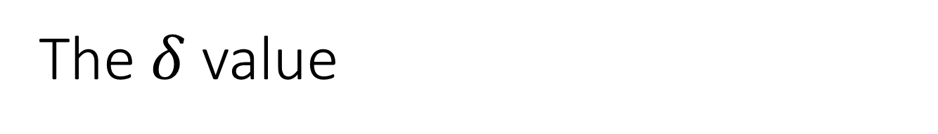
The value
The value can also be generated from the binary code!
[Kai Chen et al.] provide a method in their paper
Andorid apps
The value enjoys asymmetry between coder and attacker
[Kai Chen et al.] Leveraging Information Asymmetry to Transform Android Apps into Self-Defending Code against Repacking Attacks. IEEE Trans on Mobile Computing, Vol. 17, No. 8, 2018.

Slide 49
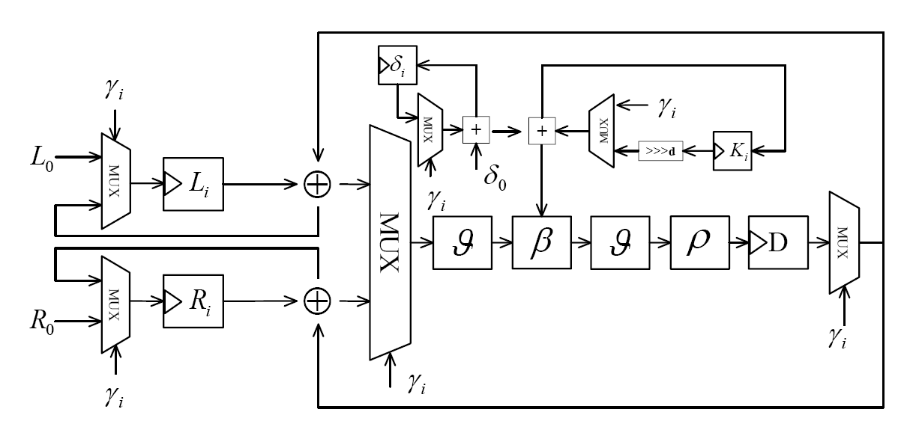
Hardware performance - parallel β function
2 cycle per round
For 64-bit block length, 1 round function costs 4*32-bit register, 2*32-bit full adder, 4 mux and 2 bit-shifting networks.

Slide 50
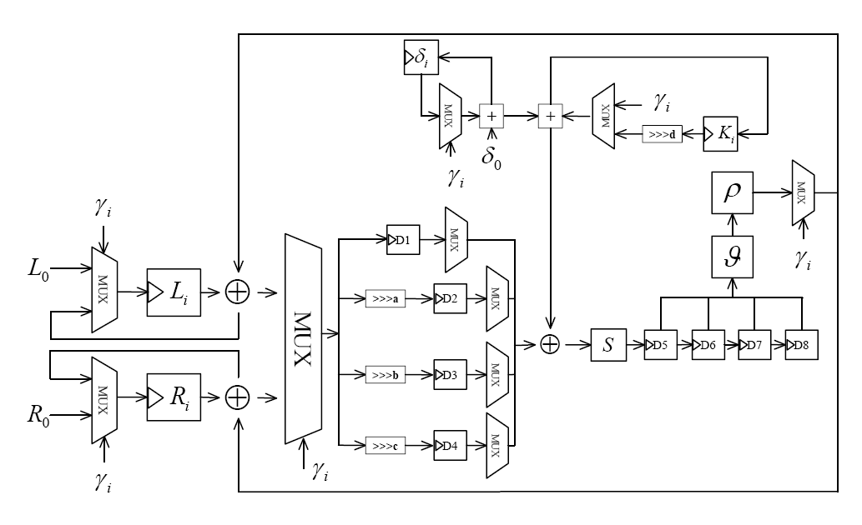
Estimated Hardware performance - serial β function
Serialize 4-branch input into 1 branch per round
1/4 area costs can be saved
β-Function
XOR
ADD
1/4 througputs
2*4=8 cycles per round

Slide 51
Side-channel resistances with TI
β-Function is easy to be threshold implemented for resisting DPA in (2,2)-Steps Sharing.
Bitslicing technique can be DCA resistant
Uses DummyRound for fault resistance
x | 0 | 1 | 2 | 3 | 4 | 5 | 6 | 7 | 8 | 9 | A | B | C | D | E | F
F(x) | 0 | 9 | 8 | 1 | 2 | B | A | 3 | F | 4 | 6 | D | 5 | E | C | 7
G(x) | 1 | 5 | 7 | F | D | 9 | B | 3 | C | 2 | A | 8 | 0 | E | 6 | 4
S(x) | 1 | 2 | C | 5 | 7 | 8 | A | F | 4 | D | B | E | 9 | 6 | 0 | 3

Slide 52
Hardware performance comparison
ST CMOS 65nm | Parallel |  |  | Serial
 | Datapath （bits） | Gate Equivalent （GE） | Throughput (Kb/s@100KHz) | Datapath （bits） | Gate Equivalent （GE） | Throughput (Kb/s@100KHz)
SWAN64 | 32 | 1440 | 100 | 8 | 1117 | 25
SWAN128 | 64 | 2895 | 133.3 | 16 | 2241 | 33.3
SWAN256 | 128 | 5744 | 200 | 32 | 4465 | 50
AES-128 | 128 | 7215 | - | 8 | 3100 | 80
Piccolo64-80 | 32 | 1136 | 237.04 | 4 | 683 | 14.8
Piccolo64-128 | 64 | 1196 | 193.9 | 4 | 758 | 12.12
SIMON64-128 | 32 | 1458 | - | - | 1000 | 16.7
SIMON128-128 | 64 | 2064 | - | - | 1317 | 22.9
SPECK64-128 | - | - | - | - | 1127 | 13.8
SPECK128-128 | - | - | - | - | 1396 | 12.1

Slide 53
Software performance comparison
VS Studio 2010 Win 7 64-bit @Intel i7-6700K 4.0GHz (with -release optimization)
 | Encryption |  | Decryption
 | Precompute | On-the-fly | Precompute | On-the-fly`
SWAN64-K128 | 481+3033 | 3082 | 481+3117 | 3909
SWAN64-K256 | 1697+6374 | 6841 | 1697+6276 | 8099
SWAN128-K128 | 908+2970 | 3427 | 908+2970 | 4191
SWAN128-K256 | 1813+3992 | 5224 | 1813+3974 | 6846
SWAN256-K256 | 3154+3969 | 6039 | 3154+3958 | 8677
SM4 | 902+947 | - | 924+961 | -
Rijndael128-128 | 916+6325 | - | 900+10818 | -
Rijndael128-256 | 1201+9013 | - | 1193+15390 | -
Rijndael256-256 | 2346+16017 | - | 2338+28579 | -

Slide 54
Software performance comparison
GCC 8.2.0 64-bit @Intel i7-6700K 4.0GHz (with -O2 optimization)
 | Encryption |  | Decryption
 | Precomputation | On-the-fly | Precomputation | On-the-fley
SWAN64-K128 | 415+1754 | 2092 | 415+1745 | 2487
SWAN64-K256 | 1695+3448 | 4907 | 1695+3431 | 6546
SWAN128-K128 | 1195+2531 | 3236 | 1195+2515 | 4597
SWAN128-K256 | 1941+3396 | 5052 | 1941+3415 | 6701
SWAN256-K256 | 3084+3519 | 6172 | 3084+3474 | 9691
SM4 | 543+838 | - | 567+837 | -
Rijndael128-128 | 949+4360 | - | 949+5458 | -
Rijndael128-256 | 1215+6171 | - | 1215+7740 | -
Rijndael256-256 | 2352+11911 | - | 2352+14981 | -

Slide 55
White-box mode costs of SWAN
 | Round | Affine Matrix |  | Affine Vector
 |  | Matrix | Numbers | Matrix | Numbers
SWAN64-K128 | 32 | 32X32 | 7/9 | 32X1 | 7/9
SWAN64-K256 | 64 | 32X32 | 7/9 | 32X1 | 7/9
SWAN128-K128 | 48 | 64X64 | 7/9 | 64X1 | 7/9
SWAN128-K256 | 64 | 64X64 | 7/9 | 64X1 | 7/9
SWAN256-K256 | 64 | 128X128 | 7/9 | 128X1 | 7/9

Slide 56
White-box implementation costs
White-box Implementation |  | WB Tables （ms） | WB Table Size | Encryption （cycles per block） | Decryption （cycles per block）
Weak | SWAN64-K128 | 546 | 470KB | 1726740 | 1835078
 | SWAN64-K256 | 1086 | 928KB | 3674112 | 3710829
 | SWAN128-K128 | 2432 | 2736KB | 4762589 | 4725159
 | SWAN128-K256 | 3291 | 3640KB | 6313290 | 6385419
 | SWAN256-K256 | 12755 | 14472KB | 11870982 | 12049519
 | SM4 | - | 400KB | - | -
 | AES | - | 770KB | - | -
 | SPACE-16[1] | - | 918KB | - | -
 | SPNbox-16[2] | - | 132KB | - | -
Strong | SWAN64-K128 | 560 | 538KB | 2169435 | 2123928
 | SWAN64-K256 | 1128 | 1063KB | 4300986 | 4307686
 | SWAN128-K128 | 2474 | 3128KB | 5545943 | 5488288
 | SWAN128-K256 | 3299 | 4163KB | 7377358 | 7384269
 | SWAN256-K256 | 12835 | 16539KB | 13821364 | 14295731
 | ASASA-64[3] | - | 2MB~9MB | - | -
 | ASASA-128[3] | - | 8MB~20GB | - | -
[1] A. Bogdanov and T. Isobe. White-box Cryptography Revisited: Space-Hard Ciphers, CCS 2015
[2] A. Bogdanov et al. Towards Practical Whitebox Cryptography: Optimizing Efficiency and Space Hardness, AC 2016
[3] A. Biryukov et al. Cryptographic Schemes Based on the ASASA Structure, AC 2014

Slide 57
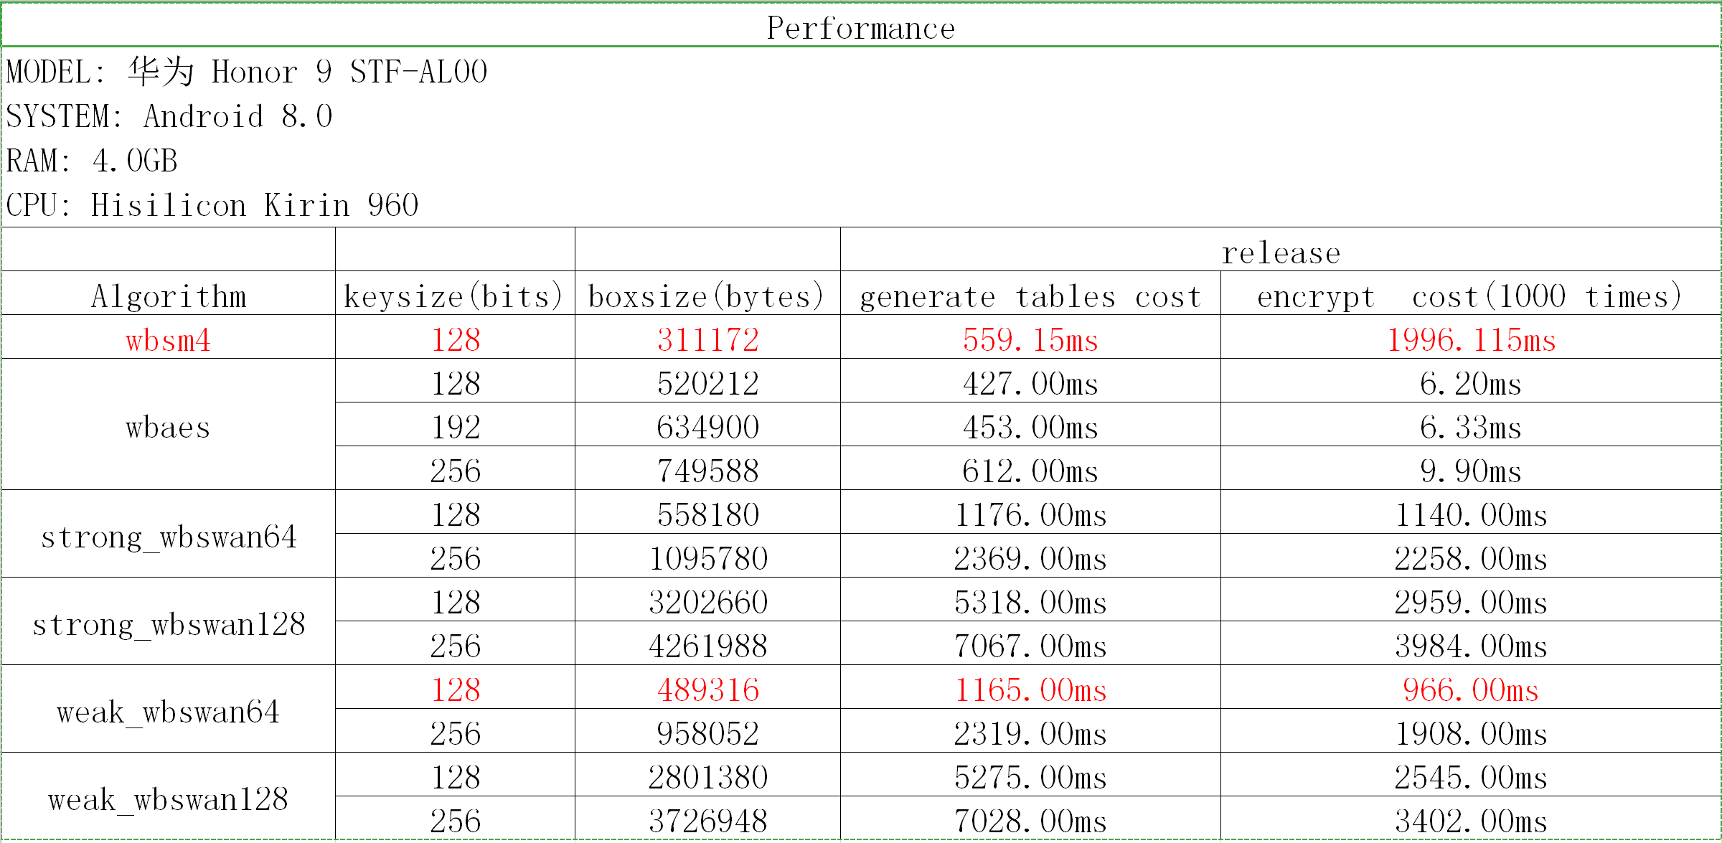
White-Box experiments on Android
*wbsm4 and weak_wbswan64 are comparable because they are on the same white-box security level (O(2³²))

Slide 58
Outlines
Design background
Research background
Related work
Our proposal: SWAN
Conclusion

Slide 59
Conclusion
Affine networks (ASASA) are necessary for white-box implementation
either SPACE-like or Chow-like
SWAN considers lightweight components
bitslicing software
serial/parallel hardware
How far SWAN can go in the white-box model needs more investigations

Slide 60
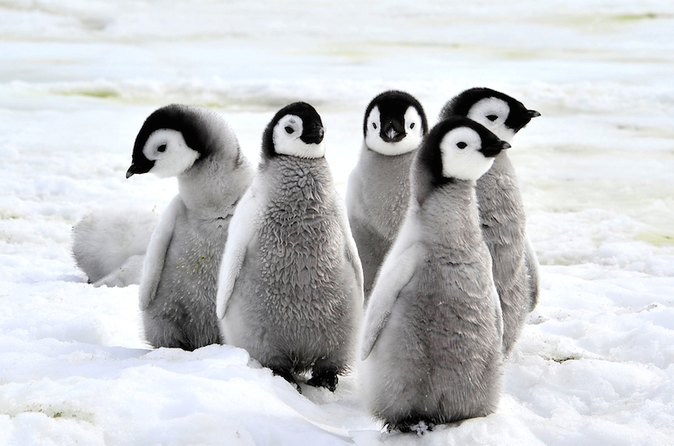
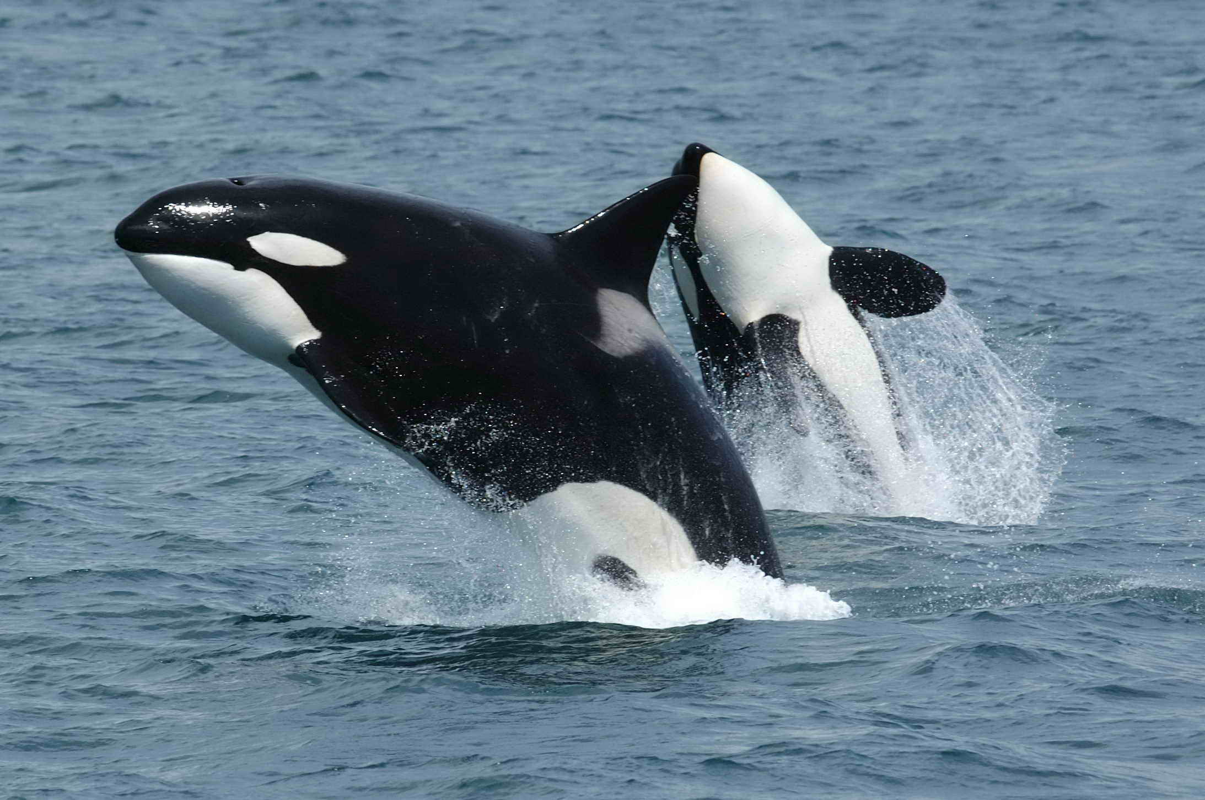
If SWAN fails?
There should be a better design with black-box and white-box friendly balance.

Slide 61
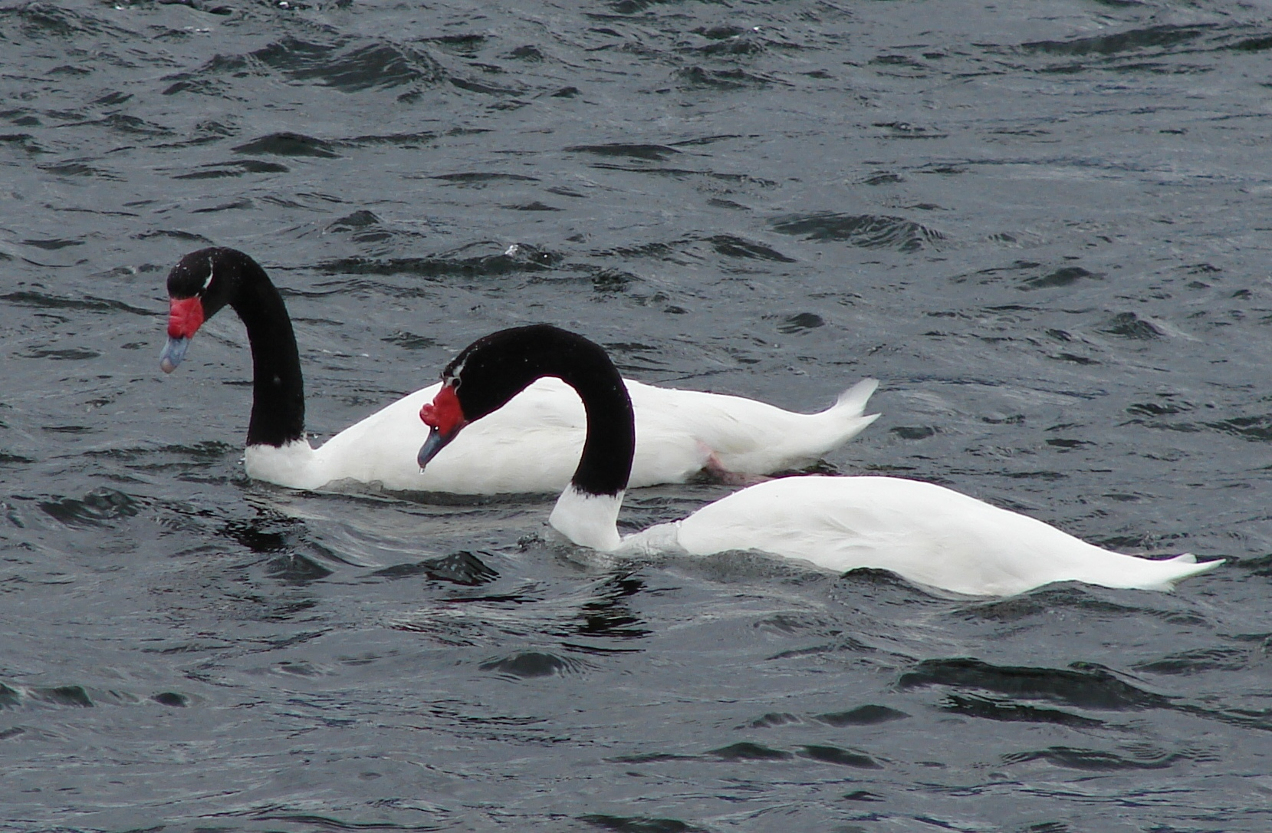
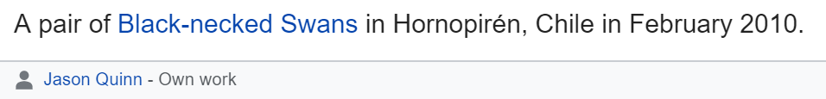
Thanks for your attention! Comments are welcome!

